Slide 1

YEARLY MONITORING

Slide 2
State and “Local Agency” Breastfeeding Initiation Data Source: PNSS
The Pregnancy Nutrition Surveillance System (PNSS) Report represents data that is collected solely from WIC clients. This indicator provides the percentage (%) of mothers that initiated breastfeeding in WIC during a given year. The data for this report comes from MI-WIC application. It is available at the State, Local Agency, and Clinic level.
Notes:
Finding data
Select “PNSS” link on slide. On the website, select “(Year) PNSS LA” > Comparison of Infant Health Indicators graph > your agency’s % Ever Breastfed. For State data, scroll to the bottom of this graph.
Updating data points/ agency name: Left click anywhere on the graph, then right click. From drop-down, select “Edit Data”. An excel spreadsheet will pop up, where Column A= dates, Column B= State data for comparison, Column C= your agency’s data. When updating for the first time, type your agency’s name into cell C1 and change column C data placeholders to your agency’s data. As you add data in future months, you may need to click and drag the blue table border to include all data within the spreadsheet.
Data point labels: depending on where your labels lie, you may want to move them. Click once to change the data labels for the entire data line, or click twice on a specific label. A “Format Data Label” pop-up should show. Select the icon that looks like a bar graph called “Label Options”. Under that, click on “> Label Options” to expand. Under “Label Position” is where you can change where your label(s) lie.
Changing Y-axis (vertical) percentage range: If your local agency data points exceed the parameters in the Y-axis, you can change those by hovering over the Y-axis and double click. A “Format Axis” pop-up should show. Select the icon that looks like a bar graph called “Axis Options”. Under that, click on “> Axis Options” to expand. Under “Bounds” is where you can change your minimum and maximum percentages on the Y-axis.

Slide 3
State and “Local Agency” Breastfeeding Initiation Data Source: PedNSS
The Pediatric Nutrition Surveillance System (PedNSS) Report represents data that is collected solely from WIC clients. Self-reported demographic, behavioral and health information is collected within LAs and verified by the CPA. Breastfeeding initiation, duration and exclusivity up to 12 months of WIC infants is highlighted. This indicator provides the percentage (%) of infants that initiated breastfeeding in WIC during a given year. The data for this report comes from the MI-WIC application. It is available at the State, LA and Clinic level.
Notes:
Finding data
Select “PedNSS” link on slide. On the website, select “(Year) PedNSS LA” > Comparison of Breastfeeding, TV Viewing, and Smoking in Household > your agency’s % Ever Breastfed. For State data, scroll to the bottom of this graph.
Updating data points/ agency name: Left click anywhere on the graph, then right click. From drop-down, select “Edit Data”. An excel spreadsheet will pop up, where Column A= dates, Column B= State data for comparison, Column C= your agency’s data. When updating for the first time, type your agency’s name into cell C1 and change column C data placeholders to your agency’s data. As you add data in future months, you may need to click and drag the blue table border to include all data within the spreadsheet.
Data point labels: depending on where your labels lie, you may want to move them. Click once to change the data labels for the entire data line, or click twice on a specific label. A “Format Data Label” pop-up should show. Select the icon that looks like a bar graph called “Label Options”. Under that, click on “> Label Options” to expand. Under “Label Position” is where you can change where your label(s) lie.
Changing Y-axis (vertical) percentage range: If your local agency data points exceed the parameters in the Y-axis, you can change those by hovering over the Y-axis and double click. A “Format Axis” pop-up should show. Select the icon that looks like a bar graph called “Axis Options”. Under that, click on “> Axis Options” to expand. Under “Bounds” is where you can change your minimum and maximum percentages on the Y-axis.

Slide 4
State and “Local Agency” 6 Month Duration Data Source: PedNSS
The Pediatric Nutrition Surveillance System (PedNSS) Report represents data that is collected solely from WIC clients. Self-reported demographic, behavioral and health information is collected within LAs and verified by the CPA. Breastfeeding initiation, duration and exclusivity up to 12 months of WIC infants is highlighted. This indicator provides the percentage (%) of infants that initiated breastfeeding in WIC during a given year. The data for this report comes from the MI-WIC application. It is available at the State, LA and Clinic level.
Notes:
Finding data
Select “PedNSS” link on slide. On the website, select “(Year) PedNSS LA” > Comparison of Breastfeeding, TV Viewing, and Smoking in Household> your agency’s % Breastfed At Least 6 Months (Do not use the “Combined 3 Years” graph further down the report). For State data, scroll to the bottom of this graph.
Updating data points/ agency name: Left click anywhere on the graph, then right click. From drop-down, select “Edit Data”. An excel spreadsheet will pop up, where Column A= dates, Column B= State data for comparison, Column C= your agency’s data. When updating for the first time, type your agency’s name into cell C1 and change column C data placeholders to your agency’s data. As you add data in future months, you may need to click and drag the blue table border to include all data within the spreadsheet.
Data point labels: depending on where your labels lie, you may want to move them. Click once to change the data labels for the entire data line, or click twice on a specific label. A “Format Data Label” pop-up should show. Select the icon that looks like a bar graph called “Label Options”. Under that, click on “> Label Options” to expand. Under “Label Position” is where you can change where your label(s) lie.
Changing Y-axis (vertical) percentage range: If your local agency data points exceed the parameters in the Y-axis, you can change those by hovering over the Y-axis and double click. A “Format Axis” pop-up should show. Select the icon that looks like a bar graph called “Axis Options”. Under that, click on “> Axis Options” to expand. Under “Bounds” is where you can change your minimum and maximum percentages on the Y-axis.

Slide 5
State and “Local Agency” 3 Month Exclusivity Data Source: PedNSS
* We think this data is wrong
The Pediatric Nutrition Surveillance System (PedNSS) Report represents data that is collected solely from WIC clients. Self-reported demographic, behavioral and health information is collected within LAs and verified by the CPA. Breastfeeding initiation, duration and exclusivity up to 12 months of WIC infants is highlighted. This indicator provides the percentage (%) of infants that initiated breastfeeding in WIC during a given year. The data for this report comes from the MI-WIC application. It is available at the State, LA and Clinic level.
Notes:
Finding data
Select “PedNSS” link on slide. On the website, select “(Year) PedNSS LA” > Comparison of Breastfeeding, TV Viewing, and Smoking in Household> your agency’s % Breastfed At Least 3 Months under Exclusive Breastfeeding. (Do not use the “Combined 3 Years” graph further down the report). For State data, scroll to the bottom of this graph.
Updating data points/ agency name: Left click anywhere on the graph, then right click. From drop-down, select “Edit Data”. An excel spreadsheet will pop up, where Column A= dates, Column B= State data for comparison, Column C= your agency’s data. When updating for the first time, type your agency’s name into cell C1 and change column C data placeholders to your agency’s data. As you add data in future months, you may need to click and drag the blue table border to include all data within the spreadsheet.
Data point labels: depending on where your labels lie, you may want to move them. Click once to change the data labels for the entire data line, or click twice on a specific label. A “Format Data Label” pop-up should show. Select the icon that looks like a bar graph called “Label Options”. Under that, click on “> Label Options” to expand. Under “Label Position” is where you can change where your label(s) lie.
Changing Y-axis (vertical) percentage range: If your local agency data points exceed the parameters in the Y-axis, you can change those by hovering over the Y-axis and double click. A “Format Axis” pop-up should show. Select the icon that looks like a bar graph called “Axis Options”. Under that, click on “> Axis Options” to expand. Under “Bounds” is where you can change your minimum and maximum percentages on the Y-axis.

Slide 6
State and “Local Agency” 6 Month Exclusivity Data Source: PedNSS
* We think this data is wrong
The Pediatric Nutrition Surveillance System (PedNSS) Report represents data that is collected solely from WIC clients. Self-reported demographic, behavioral and health information is collected within LAs and verified by the CPA. Breastfeeding initiation, duration and exclusivity up to 12 months of WIC infants is highlighted. This indicator provides the percentage (%) of infants that initiated breastfeeding in WIC during a given year. The data for this report comes from the MI-WIC application. It is available at the State, LA and Clinic level.
Notes:
Finding data
Select “PedNSS” link on slide. On the website, select “(Year) PedNSS LA” > Comparison of Breastfeeding, TV Viewing, and Smoking in Household> your agency’s % Breastfed At Least 6 Months under Exclusive Breastfeeding. (Do not use the “Combined 3 Years” graph further down the report). For State data, scroll to the bottom of this graph.
Updating data points/ agency name: Left click anywhere on the graph, then right click. From drop-down, select “Edit Data”. An excel spreadsheet will pop up, where Column A= dates, Column B= State data for comparison, Column C= your agency’s data. When updating for the first time, type your agency’s name into cell C1 and change column C data placeholders to your agency’s data. As you add data in future months, you may need to click and drag the blue table border to include all data within the spreadsheet.
Data point labels: depending on where your labels lie, you may want to move them. Click once to change the data labels for the entire data line, or click twice on a specific label. A “Format Data Label” pop-up should show. Select the icon that looks like a bar graph called “Label Options”. Under that, click on “> Label Options” to expand. Under “Label Position” is where you can change where your label(s) lie.
Changing Y-axis (vertical) percentage range: If your local agency data points exceed the parameters in the Y-axis, you can change those by hovering over the Y-axis and double click. A “Format Axis” pop-up should show. Select the icon that looks like a bar graph called “Axis Options”. Under that, click on “> Axis Options” to expand. Under “Bounds” is where you can change your minimum and maximum percentages on the Y-axis.

Slide 7

BI-ANNUAL MONITORING

Slide 8
State and “Local Agency” Breastfeeding Initiation Data Source: Ad-Hoc Report
The Breastfeeding Initiation Ad-Hoc Reports provides a point-in-time look at current breastfeeding initiation number and percentage (%) for the local agency. Initiation data is pulled from the 1st page, the Rate report. This report provides the number and percentages based on the total number of infants enrolled. The denominator is the total number of infants.
Notes:
Finding data
Select “Ad-Hoc Reports” link on slide. On the website, select desired Ad-Hoc report. On page 1, look under % Infants Initiated BF for State and agency data.
Updating data points/ agency name: Left click anywhere on the graph, then right click. From drop-down, select “Edit Data”. An excel spreadsheet will pop up, where Column A= dates, Column B= State data for comparison, Column C= your agency’s data. When updating for the first time, type your agency’s name into cell C1 and change column C data placeholders to your agency’s data. As you add data in future months, you may need to click and drag the blue table border to include all data within the spreadsheet.
Data point labels: depending on where your labels lie, you may want to move them. Click once to change the data labels for the entire data line, or click twice on a specific label. A “Format Data Label” pop-up should show. Select the icon that looks like a bar graph called “Label Options”. Under that, click on “> Label Options” to expand. Under “Label Position” is where you can change where your label(s) lie.
Changing Y-axis (vertical) percentage range: If your local agency data points exceed the parameters in the Y-axis, you can change those by hovering over the Y-axis and double click. A “Format Axis” pop-up should show. Select the icon that looks like a bar graph called “Axis Options”. Under that, click on “> Axis Options” to expand. Under “Bounds” is where you can change your minimum and maximum percentages on the Y-axis.

Slide 9
State and “Local Agency” 6 Month Duration Data Source: Ad-Hoc Report
The Breastfeeding Duration Ad-Hoc Reports provides a point-in-time look at current breastfeeding duration number and percentage (%) for the LA at 1 week, 2 weeks, 4 weeks, 6 weeks, 2 months, 6 months and 11+ months. Duration data is pulled from the 2nd page, the Duration report This report provides the number and % based on infants who initiated breastfeeding, not the total number of infants in WIC. The denominator is the # of infants that initiated breastfeeding.
Notes:
Finding data
Select “Ad-Hoc Reports” link on slide. On the website, select desired Ad-Hoc report. On page 2, look under 6 Months % Duration for State and agency data.
Updating data points/ agency name: Left click anywhere on the graph, then right click. From drop-down, select “Edit Data”. An excel spreadsheet will pop up, where Column A= dates, Column B= State data for comparison, Column C= your agency’s data. When updating for the first time, type your agency’s name into cell C1 and change column C data placeholders to your agency’s data. As you add data in future months, you may need to click and drag the blue table border to include all data within the spreadsheet.
Data point labels: depending on where your labels lie, you may want to move them. Click once to change the data labels for the entire data line, or click twice on a specific label. A “Format Data Label” pop-up should show. Select the icon that looks like a bar graph called “Label Options”. Under that, click on “> Label Options” to expand. Under “Label Position” is where you can change where your label(s) lie.
Changing Y-axis (vertical) percentage range: If your local agency data points exceed the parameters in the Y-axis, you can change those by hovering over the Y-axis and double click. A “Format Axis” pop-up should show. Select the icon that looks like a bar graph called “Axis Options”. Under that, click on “> Axis Options” to expand. Under “Bounds” is where you can change your minimum and maximum percentages on the Y-axis.

Slide 10

MONTHLY MONITORING

Slide 11
“Local Agency” Breastfeeding Initiation Data Source: Pre-defined Reports
Notes:
Finding data
In the clinic module, select “Miscellaneous”, then “Pre-defined Reports”. Select “Frequency Table” and “Local Agency”, then select your agency from the drop-down. Click “Continue”.
Under “Major Characteristics”, select “Breastfeeding Initiation”, then “Continue”. Under the WIC Client Category section of Screen 3, select the IBE, IBP, and IFF categories. Select “Continue” to reach the Summary screen where you can title your report. Select “Submit”.
Updating data points/ agency name: Left click anywhere on the graph, then right click. From drop-down, select “Edit Data”. An excel spreadsheet will pop up, where Column A= dates, Column B= your agency’s data. When updating for the first time, change column B data placeholders to your agency’s data. As you add data in future months, you may need to click and drag the blue table border and the highlighted section to include all data within the spreadsheet.
Data point labels: depending on where your labels lie, you may want to move them. Click once to change the data labels for the entire data line, or click twice on a specific label. A “Format Data Label” pop-up should show. Select the icon that looks like a bar graph called “Label Options”. Under that, click on “> Label Options” to expand. Under “Label Position” is where you can change where your label(s) lie.
Changing Y-axis (vertical) percentage range: If your local agency data points exceed the parameters in the Y-axis, you can change those by hovering over the Y-axis and double click. A “Format Axis” pop-up should show. Select the icon that looks like a bar graph called “Axis Options”. Under that, click on “> Axis Options” to expand. Under “Bounds” is where you can change your minimum and maximum percentages on the Y-axis.

Slide 12
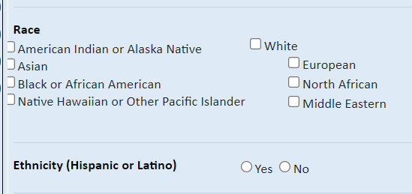
Breastfeeding Initiation Based on Race and Ethnicity
Notes:
For agencies interested in monitoring breastfeeding initiation by race, you can pull the Racial/ Ethnic Participation by Category report to narrow down your agency’s highest racial populations. Use the next slides as a guide for pulling/ utilizing this report.

Slide 13
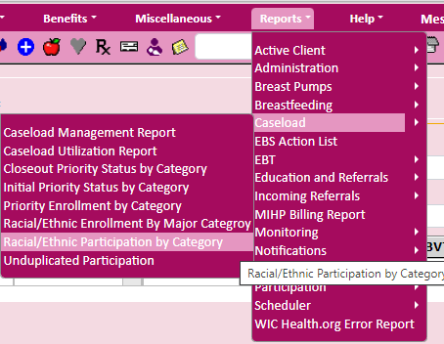
Step 1: Pull local agency caseload by race
Notes:
In the Clinic Module, select Reports > Caseload > Racial/ Ethnic Participation by Category

Slide 14
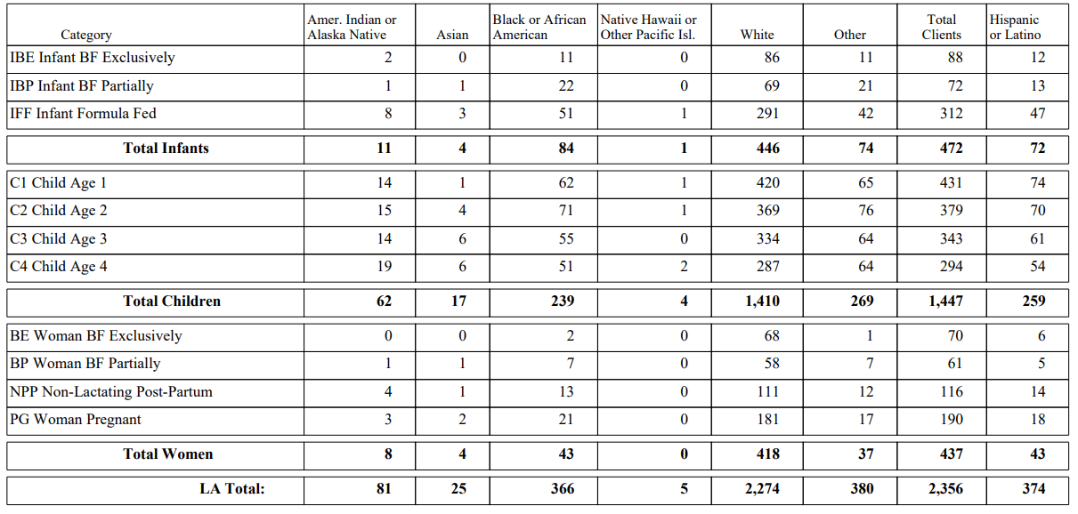
Step 2: Category determination
Notes:
Determine which 2-3 racial/ ethnic categories have the highest population in your agency
**On this report, “other” means the client selected more than one race.

Slide 15
“Local Agency” Breastfeeding Initiation Based on Race and Ethnicity Data Source: Pre-defined Reports
Notes:
Finding data
In the clinic module, select “Miscellaneous”, then “Pre-defined Reports”. Select “Frequency Table” and “Local Agency”, then select your agency from the drop-down. Click “Continue”.
Under “Major Characteristics”, select “Breastfeeding Initiation”, then “Continue”. Under the Race section of Screen 1, select your race categories of the highest population (pull individually). Select “Continue” until you until you reach the Summary screen where you can title your report. Select “Submit”.
Updating data points: Left click anywhere on the graph, then right click. From drop-down, select “Edit Data”. An excel spreadsheet will pop up, where Column A= dates and Columns B,C and D= your agency’s data. When updating for the first time, change column B,C and D data placeholders to your agency’s data. As you add data in future months, you may need to click and drag the blue table border and the highlighted section to include all data within the spreadsheet.
Data point labels: depending on where your labels lie, you may want to move them. Click once to change the data labels for the entire data line, or click twice on a specific label. A “Format Data Label” pop-up should show. Select the icon that looks like a bar graph called “Label Options”. Under that, click on “> Label Options” to expand. Under “Label Position” is where you can change where your label(s) lie.
Changing Y-axis (vertical) percentage range: If your local agency data points exceed the parameters in the Y-axis, you can change those by hovering over the Y-axis and double click. A “Format Axis” pop-up should show. Select the icon that looks like a bar graph called “Axis Options”. Under that, click on “> Axis Options” to expand. Under “Bounds” is where you can change your minimum and maximum percentages on the Y-axis.

Slide 16
“Local Agency” 6 Month Duration Data Source: Pre-defined Reports
Notes:
Clients may be counted more than once. For example, at 3 months and again at 6 months.
Finding data
In the clinic module, select “Miscellaneous”, then “Pre-defined Reports”. Select “Frequency Table” and “Local Agency”, then select your agency from the drop-down. Click “Continue”.
Under “Major Characteristics”, select “Breastfeeding Duration”, then “Continue”. Under the WIC Client Category section of Screen 3, select the IBE, IBP, and IFF categories. Select “Continue” to reach the Summary screen where you can title your report. Select “Submit”.
Updating data points/ agency name: Left click anywhere on the graph, then right click. From drop-down, select “Edit Data”. An excel spreadsheet will pop up, where Column A= dates, Column B= your agency’s data. When updating for the first time, change column B data placeholders to your agency’s data. As you add data in future months, you may need to click and drag the blue table border and the highlighted section to include all data within the spreadsheet.
Data point labels: depending on where your labels lie, you may want to move them. Click once to change the data labels for the entire data line, or click twice on a specific label. A “Format Data Label” pop-up should show. Select the icon that looks like a bar graph called “Label Options”. Under that, click on “> Label Options” to expand. Under “Label Position” is where you can change where your label(s) lie.
Changing Y-axis (vertical) percentage range: If your local agency data points exceed the parameters in the Y-axis, you can change those by hovering over the Y-axis and double click. A “Format Axis” pop-up should show. Select the icon that looks like a bar graph called “Axis Options”. Under that, click on “> Axis Options” to expand. Under “Bounds” is where you can change your minimum and maximum percentages on the Y-axis.
**Duplicate this slide if you wish to monitor other duration data.

Slide 17
“Local Agency” 3 Month Exclusivity Data Source: Pre-defined Reports
* We think this data is wrong
Notes:
Finding data
In the clinic module, select “Miscellaneous”, then “Pre-defined Reports”. Select “Frequency Table” and “Local Agency”, then select your agency from the drop-down. Click “Continue”.
Under “Major Characteristics”, select “Breastfeeding Exclusivity”, then “Continue”. Under the WIC Client Category section of Screen 3, select the IBE, IBP, and IFF categories. Select “Continue” to reach the Summary screen where you can title your report. Select “Submit”.
Updating data points/ agency name: Left click anywhere on the graph, then right click. From drop-down, select “Edit Data”. An excel spreadsheet will pop up, where Column A= dates, Column B= your agency’s data. When updating for the first time, change column B data placeholders to your agency’s data. As you add data in future months, you may need to click and drag the blue table border and the highlighted section to include all data within the spreadsheet.
Data point labels: depending on where your labels lie, you may want to move them. Click once to change the data labels for the entire data line, or click twice on a specific label. A “Format Data Label” pop-up should show. Select the icon that looks like a bar graph called “Label Options”. Under that, click on “> Label Options” to expand. Under “Label Position” is where you can change where your label(s) lie.
Changing Y-axis (vertical) percentage range: If your local agency data points exceed the parameters in the Y-axis, you can change those by hovering over the Y-axis and double click. A “Format Axis” pop-up should show. Select the icon that looks like a bar graph called “Axis Options”. Under that, click on “> Axis Options” to expand. Under “Bounds” is where you can change your minimum and maximum percentages on the Y-axis.

Slide 18
“Local Agency” 6 Month Exclusivity Data Source: Pre-defined Reports
* We think this data is wrong
Notes:
Finding data
In the clinic module, select “Miscellaneous”, then “Pre-defined Reports”. Select “Frequency Table” and “Local Agency”, then select your agency from the drop-down. Click “Continue”.
Under “Major Characteristics”, select “Breastfeeding Exclusivity”, then “Continue”. Under the WIC Client Category section of Screen 3, select the IBE, IBP, and IFF categories. Select “Continue” to reach the Summary screen where you can title your report. Select “Submit”.
Updating data points/ agency name: Left click anywhere on the graph, then right click. From drop-down, select “Edit Data”. An excel spreadsheet will pop up, where Column A= dates, Column B= your agency’s data. When updating for the first time, change column B data placeholders to your agency’s data. As you add data in future months, you may need to click and drag the blue table border and the highlighted section to include all data within the spreadsheet.
Data point labels: depending on where your labels lie, you may want to move them. Click once to change the data labels for the entire data line, or click twice on a specific label. A “Format Data Label” pop-up should show. Select the icon that looks like a bar graph called “Label Options”. Under that, click on “> Label Options” to expand. Under “Label Position” is where you can change where your label(s) lie.
Changing Y-axis (vertical) percentage range: If your local agency data points exceed the parameters in the Y-axis, you can change those by hovering over the Y-axis and double click. A “Format Axis” pop-up should show. Select the icon that looks like a bar graph called “Axis Options”. Under that, click on “> Axis Options” to expand. Under “Bounds” is where you can change your minimum and maximum percentages on the Y-axis.

