Slide 1
Michigan WIC CPA Training: Breastfeeding

Slide 2
What will we cover today?
Breastfeeding Benefits
Data and Statistics
Policies
Management Evaluations (ME)
Documentation in MI-WIC
Role of the CPA in promotion of exclusive breastfeeding
Food Packages
Website

Slide 3
What will we cover today?
Breastfeeding benefits
Data and Statistics
Policies
Management Evaluations (ME)
Documentation in MI-WIC
Role of the CPA in promotion of exclusive breastfeeding
Food Packages
Website

Slide 4
Why is it important to support breastfeeding?
Healthier baby
Healthier mom
Healthier community

Slide 5
Healthier baby
50% decrease in ear infections
64% decrease in gastroenteritis
58% decrease in necrotizing enterocolitis
72% decrease in lower respiratory tract infections
32% decrease in atopic dermatitis
73% decrease in sleep-related deaths (SIDS)
27% decrease in childhood asthma
20% decrease in ALL (acute lymphocytic leukemia) and 15% decrease in AML (acute myelogenous leukemia)
25% decrease in Type I diabetes

Slide 6
Healthier baby
50% decrease in ear infections
64% decrease in gastroenteritis
58% decrease in necrotizing enterocolitis
72% decrease in lower respiratory tract infections
32% decrease in atopic dermatitis
73% decrease in sleep-related deaths (SIDS)
27% decrease in childhood asthma
20% decrease in ALL (acute lymphocytic leukemia) and 15% decrease in AML (acute myelogenous leukemia)
25% decrease in Type I diabetes

Slide 7
Healthier mom
44% decrease in myocardial infarction
4.3% decrease in breast cancer for every year of breastfeeding
44% decrease in premenopausal ovarian cancer
47% decrease in Type 2 diabetes
22% decrease in hypertension

Slide 8
Healthier mom
44% decrease in myocardial infarction
4.3% decrease in breast cancer for every year of breastfeeding
44% decrease in premenopausal ovarian cancer
47% decrease in Type 2 diabetes
22% decrease in hypertension

Slide 9
What will we cover today?
Breastfeeding benefits
Data and Statistics
Policies
Management Evaluations (ME)
Documentation in MI-WIC
Role of the CPA in promotion of exclusive breastfeeding
Food Packages
Website

Slide 10
Where can you find breastfeeding data?
WIC-Specific Data
Guidance for Michigan WIC Breastfeeding Data
Breastfeeding Rate and Duration Ad-Hoc Reports
Pregnancy Nutrition Surveillance System (PNSS) for breastfeeding initiation of WIC mothers.
Pediatric Nutrition Surveillance System (PedNSS) for breastfeeding initiation, duration and exclusivity for WIC infants.
Non-WIC Breastfeeding Data
Michigan Pregnancy Risk Assessment Monitoring System (PRAMS)
Michigan Department of Health and Human Services (MDHHS) Maternal Child Health Epidemiology Reports
Michigan Maternity Practices in Infant Nutrition and Care (mPINC) 2018 Report
Centers for Disease Control (CDC) Breastfeeding 2018 Report Card
Centers for Disease Control (CDC) 2018-2019 Breastfeeding Rates (for children born in 2017) from National Immunization Survey (NIS)
Notes:
Don’t go through each of these. We have data. It’s on the website. Relate to the NSP and breastfeeding goals.

Slide 11
What will we cover today?
Breastfeeding benefits
Data and Statistics
Policies
Management Evaluations (ME)
Documentation in MI-WIC
Role of the CPA in promotion of exclusive breastfeeding
Food Packages
Website

Slide 12
Breastfeeding Policies
4.01 Local Agency Breastfeeding Responsibilities and Staff Roles New! 4.02 Client Breastfeeding Education New! 4.03 Contraindications to Exclusive Breastfeeding New! 4.04 Breastfeeding Equipment, Inventory and Maintenance 4.04A Loaner Breast Pump Return Receipt 4.04B Multiple-User Electric Breast Pump Repair Procedure for Evenflo/Ameda Elite Pumps 4.04C Multiple-User Electric Breast Pump Repair Procedure for Medeka Lactina Pumps 4.05 Issuance of Multiple User Breast Pumps 4.05A Description of Multi-User Breast Pumps 4.05B Multi-Use Breast Pump Loan and Release Agreement 4.06 Issuance of Personal Use Electric Breast Pumps 4.06A Description of Personal Use Electric Breast Pumps 4.06B Single-User Breast Pump Release Agreement 4.07 Issuance of Manual Breast Pumps 4.07A Description of Manual Breast Pumps (Single-User) 4.08 Lost/Stolen Breastfeeding Equipment 4.08A Sample Local Agency Breast Pump Retrieval Letter 4.09 Specialty Feeding Equipment 4.09A Silicone Nipple Shields 4.09B Supplemental Nursing System or Transitional Nursing System 4.09C Finger Feeding with Supplemental/Transitional Nursing System 4.09D Feeding Cup

Slide 13
Key Take-Aways from Breastfeeding Policies
4.01: Local Agency BF Responsibilities and Staff Roles
All staff need to encourage, educate, and support clients in their breastfeeding decisions.
All staff needs to be trained = policies & program goals, training requirements, breast pump issuance.
Clinic environment = materials, posters, welcome to breastfeed anywhere.
4.02: Client BF Education
Respect a client’s informed decision for feeding their infant.
Make referrals, minimize supplementation, refer to the PC, offer classes and support groups.
Pay attention to timing of required contacts

Slide 14
Key Take-Aways from Breastfeeding Policies cont’d
4.03: Contraindications to Exclusive Breastfeeding
Not advisable with infant galactosemia, HIV positive, infection with human T-cell lymphotropic virus, certain medications (chemotherapy, amphetamine, ergotamine, statin, codeine or tramadol)
Modify breastfeeding in a client with tuberculosis or brucellosis, or an open herpes lesion on breast.
Guidance on maternal substance misuse and blood lead levels.
4.05-4.08: Breastfeeding Equipment
In the process of being revised.
Remember to educate clients on pump use and sign the release forms.

Slide 15
What will we cover today?
Breastfeeding benefits
Data and Statistics
Policies
Management Evaluations (ME)
Documentation in MI-WIC
Role of the CPA in promotion of exclusive breastfeeding
Food Packages
Website

Slide 16
Management Evaluations: Breastfeeding Focus
Key Issues
Pumps issued without a signed release.
Loaner pumps not being monitored monthly.
Pumps returned without a signed receipt.
Required breastfeeding staff training not completed and/or not documented.
No referral made for breastfeeding support.
No follow-up documented after certification.
No education support and/or documentation for PG women.
PC referral made but no follow-up documentation.

Slide 17
What will we cover today?
Breastfeeding benefits
Data and Statistics
Breastfeeding Policies
Management Evaluations (ME)
Documentation in MI-WIC
Role of the CPA in promotion of exclusive breastfeeding
Food Packages
Website

Slide 18
Screens for Women

Slide 19
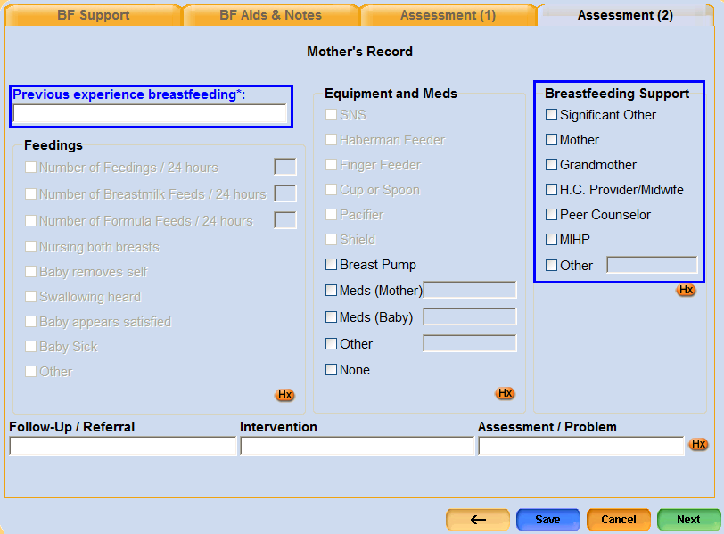
Documentation: Mom’s Record

Slide 20
Screens for Infants

Slide 21
BF Statistics
Initiation
Duration
Exclusivity
Notes:
Questions need to be answered at certification and anytime a category changes

Slide 22
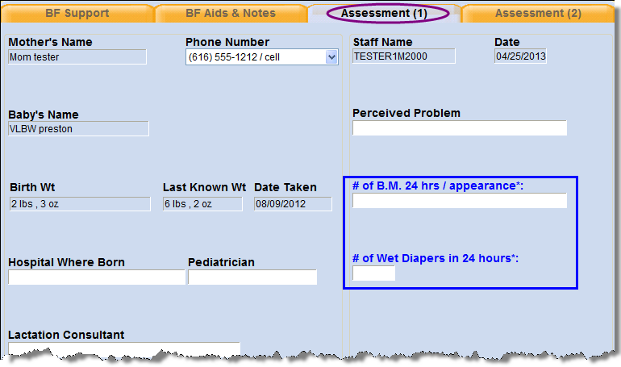
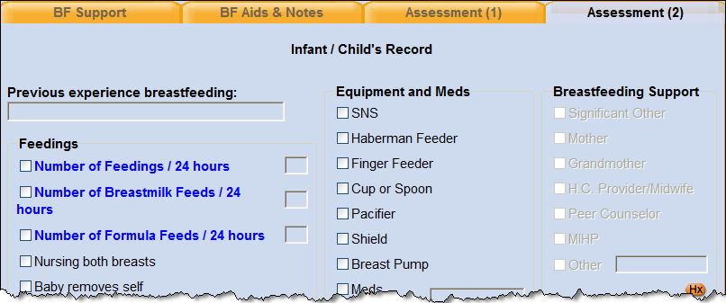
Documentation: Infant’s Record

Slide 23
What will we cover today?
Breastfeeding benefits
Data and Statistics
Breastfeeding Policies
Management Evaluations (ME)
Documentation in MI-WIC
Role of the CPA in promotion of exclusive breastfeeding
Breastfeeding Food Packages
Website

Slide 24
Time for a self-assessment: What is your comfort level in discussing breastfeeding?

Slide 25
How can you increase your breastfeeding knowledge and skills?

Slide 26
Attend Breastfeeding Basics within one year of hire

Slide 27
Watch Great Lakes Breastfeeding Webinars Access at MiBreastfeeding.org. Provides contact hours for nurses, social workers, dietitians and IBCLC/CLC.
Notes:
Hand out webinar postcards.

Slide 28
Take advantage of our advanced
breastfeeding training options:
CLS (certified lactation specialist)
LCE (lactation counselor educator)
Book Club

Slide 29
Attend Building Bridges training

Slide 30
Watch one-hour Coffective overview video, asap.
Watch all 5 Coffective modules within next 3 months.

Slide 31
How can you support breastfeeding in your clinic?

Slide 32
Know which breastfeeding education materials are available.
https://www.michigan.gov/mdhhs/0,5885,7-339-71547_4910_19205-493743--,00.html
Notes:
Handout: WIC publications

Slide 33
Know which Coffective materials are available and how to obtain them.
https://www.michigan.gov/documents/mihp/Coffective_Materials_Available_to_MI_WIC_agencies_659433_7.pdf
Notes:
Handout: Coffective materials available to Michigan WIC.

Slide 34
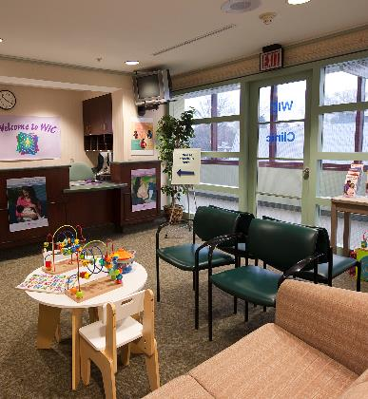
Create a clinic environment that supports breastfeeding families
Notes:
Handout: Free Coffective Key Message posters
WIC clients feel comfortable asking questions of staff.
Infants are able to breastfeed while in clinic.
A private breastfeeding area is available, if needed.
Posters and pictures that promote breastfeeding are everywhere.
Formula and bottle-feeding equipment are stored out of sight.
Incentive items are free of formula products names and logos.
Culturally sensitive breastfeeding educational materials are available.

Slide 35
Determining Progress & Problem-solving
Ask open-ended questions
How?
What?
When?
Where?
Assess
Affirm Feelings/
validate concerns
Educate
Problem-solve
Identify other supports
Notes:
How is it going? How do you feel about breastfeeding? Who ends the feedings?
What concerns do you have?
Assess= Asking questions, obtain info, plan a course of action if needed
It sounds like I am hearing you say…..
Anticipatory guidance
This is a resource/person that may help answer that question or work through these issues.

Slide 36
WIC Breastfeeding Support Services
CPAs
Assess, provide support and refer
PEER COUNSELORS
Role model for breastfeeding
Gives mother-to-mother support
Provide BF support within their scope of practice
BF CREDENTIALED STAFF (CLS, CLC, IBCLC) can provide further assistance for WIC families
Notes:
What is the scope of practice for a WIC peer counselor? Can hand out a document titled “Staffing and Supervision 5: Scope of Practice for the WIC Peer Counselor.

Slide 37
Referral decision tree for breastfeeding support
CPA
What should I do?
Support or refer? Who should I refer to?
The CPA’s role is to assess breastfeeding problems, provide basic support and refer as necessary.
Notes:
What is the scope of practice for a WIC peer counselor? Can hand out a document titled “Staffing and Supervision 5: Scope of Practice for the WIC Peer Counselor.

Slide 38
Referral decision tree for breastfeeding support
CPA
Embarrassed to BF in public
CPA or Peer
What should I do?
Support or refer? Who should I refer to?
Notes:
What is the scope of practice for a WIC peer counselor? Can hand out a document titled “Staffing and Supervision 5: Scope of Practice for the WIC Peer Counselor.

Slide 39
Referral decision tree for breastfeeding support
CPA
Milk supply decreasing
Embarrassed to BF in public
What should I do?
Support or refer? Who should I refer to?
BF Credentialed Staff
Notes:
What is the scope of practice for a WIC peer counselor? Can hand out a document titled “Staffing and Supervision 5: Scope of Practice for the WIC Peer Counselor.

Slide 40
Referral decision tree for breastfeeding support
CPA
Milk supply decreasing
Embarrassed to BF in public
Returning to work & needs help with pumping schedule.
What should I do?
Support or refer? Who should I refer to?
CPA or Peer
Notes:
What is the scope of practice for a WIC peer counselor? Can hand out a document titled “Staffing and Supervision 5: Scope of Practice for the WIC Peer Counselor.

Slide 41
Referral decision tree for breastfeeding support
CPA
MD told mom to ‘pump and dump’ when prescribed new medication.
Milk supply decreasing
Embarrassed to BF in public
Returning to work & needs help with pumping schedule.
What should I do?
Support or refer? Who should I refer to?
BF Credentialed Staff
Notes:
What is the scope of practice for a WIC peer counselor? Can hand out a document titled “Staffing and Supervision 5: Scope of Practice for the WIC Peer Counselor.

Slide 42
What will we cover today?
Breastfeeding benefits
Data and Statistics
Breastfeeding Policies
Management Evaluations (ME)
Documentation in MI-WIC
Role of the CPA in promotion of exclusive breastfeeding
Breastfeeding Food Packages
Website

Slide 43
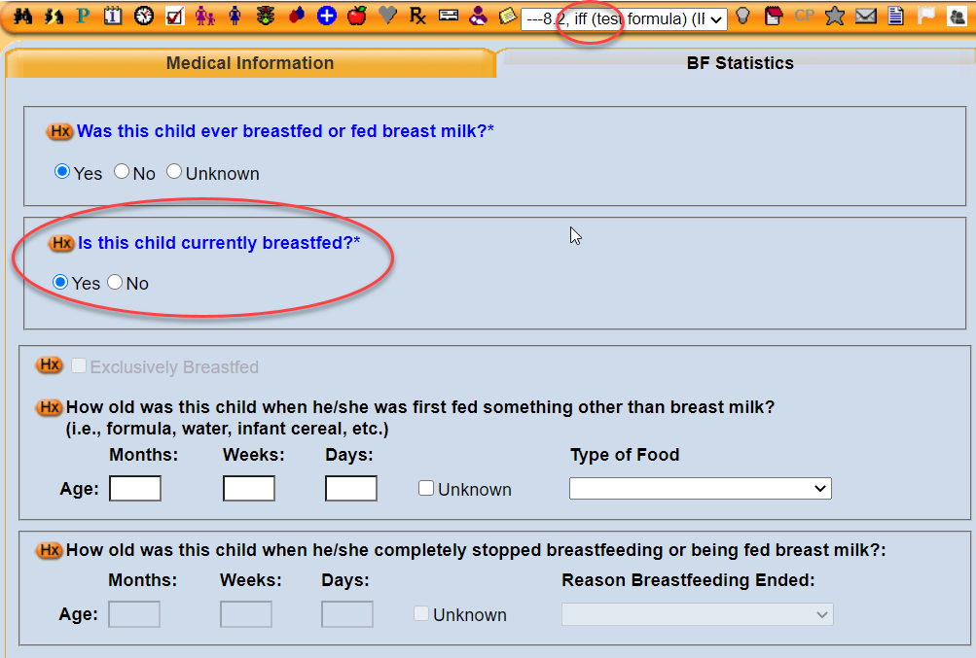
Assessing for food packages:
Michigan’s food package assignment information can be found here
A partially BF infant (IBP) can only receive 1 can of formula in the 1st month so if they want more than that they must be categorized as a formula fed infant (IFF).
After the 2nd month, they can be changed back to an IBP. We have also made a recent system update to capture if a formula-fed infant is receiving any breast milk to help with our statistics.

Slide 44
How can you (CPAs) support our families?
Understand the fear of not making enough milk.
When families call and ask to be changed to an IFF/NPP category, ask why. Are they breastfeeding at all? Counsel on ways they can know if they are making enough milk. Educate on supply and demand. It doesn’t have to be al or nothing. Encourage families to try and reassure them that they can call if they need more formula.
Know how to tailor a food package to the amount a baby is getting.
Understand how to support a mom to exclusively breastfeed.
Notes:
Understand the fear of not making enough milk.
When they ask to be changed to an IFF/NPP category, ask why? Are they breastfeeding at all? Counsel on ways they can know if they are making enough milk. Educate on supply and demand. Encourage them to try and reassure them that they can call if they need more formula.

Slide 45
How can you (CPAs) support our families?
Understand the fear of not making enough milk.
Know how to tailor a food package to the amount a baby is getting.
Have a conversation with the parents (about BF goals, why formula is being used, # of formula feeds, oz. per feeding)
Know the reconstituted value for a can of a specific formula (i.e., Gentlease can of powder = 87 oz.)
If formula is continued, factor in the increases in ounces over the benefit issuance period.
Note: don’t calculate more than 6 oz/ feeding when calculating.
Understand how to support a mom to exclusively breastfeed.
Notes:
Understand the fear of not making enough milk.
When they ask to be changed to an IFF/NPP category, ask why? Are they breastfeeding at all? Counsel on ways they can know if they are making enough milk. Educate on supply and demand. Encourage them to try and reassure them that they can call if they need more formula.

Slide 46
How can you (CPAs) support our families?
Understand the fear of not making enough milk.
Know how to tailor a food package to the amount a baby is getting.
Understand how to support a mom to exclusively breastfeed.
Explain the impact of formula on gut biome.
Give talking points she can share with her family/support system.
Provide practical advice on how to return to work/school.
Support her efforts with a breast pump, as needed.
Celebrate small victories with her!
Notes:
Understand the fear of not making enough milk.
When they ask to be changed to an IFF/NPP category, ask why? Are they breastfeeding at all? Counsel on ways they can know if they are making enough milk. Educate on supply and demand. Encourage them to try and reassure them that they can call if they need more formula.

Slide 47
Help with tricky BF food package questions
Breastfeeding Food Package Guidance PPT
Breastfeeding Food Package Cheat Sheet

Slide 48
What will we cover today?
Breastfeeding benefits
Data and Statistics
Breastfeeding Policies
Management Evaluations (ME)
Documentation in MI-WIC
Role of the CPA in promotion of exclusive breastfeeding
Breastfeeding Food Packages
Website

Slide 49
There are 2 places on the WIC website to find breastfeeding information: WIC Providers and WIC Clients

Slide 50
State WIC Breastfeeding Team
Marji Cyrul, MPH, RD, CLS
WIC State Breastfeeding Coordinator
(517) 335-9836
CyrulM@Michigan.gov
Dionne Moore-Smith, MPH, RD, IBCLC
WIC Breastfeeding Peer Counselor Coordinator
(517) 335-9174
MooreSmithD@Michigan.gov
Hanna Thelen
WIC Breastfeeding/Nutrition Analyst
ThelenH1@Michigan.gov
(517) 335-8631

